Slide 1
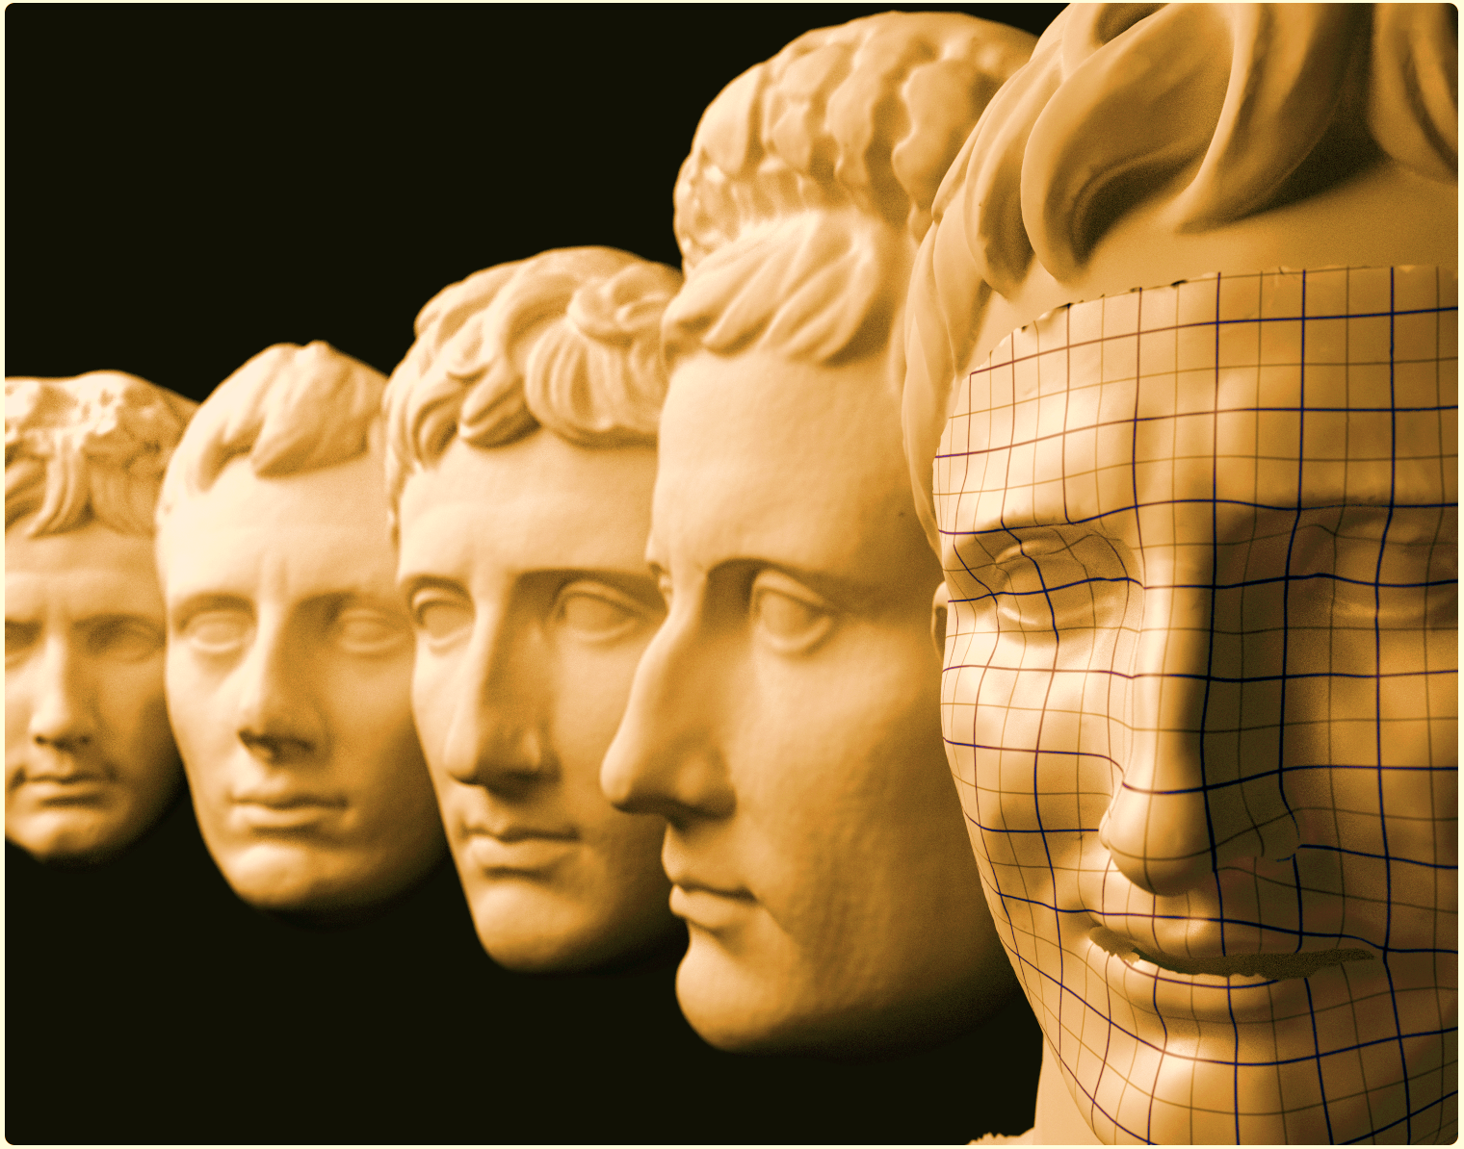
Visualization and Deformation Techniques for
Entertainment and Training
in Cultural Heritage
M. Zollhöfer, J. Süßmuth, F. Bauer, M. Stamminger M. Boss
Computer Graphics Group, FAU Erlangen-Nuremberg Classical Archeology, FAU Erlangen-Nuremberg
8th International Symposium on Image and Signal Processing and Analysis (ISPA 2013)
September 4-6, 2013, Trieste,Italy

Slide 2
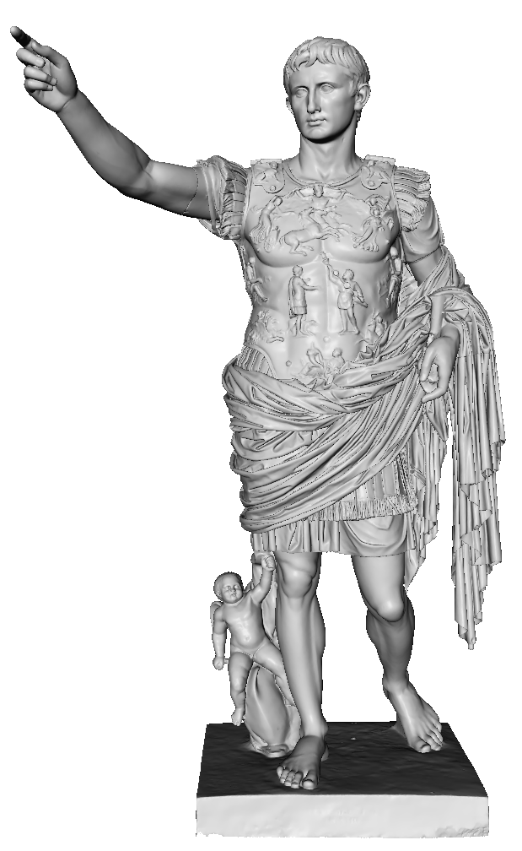
Overview
Motivation
Building Blocks
Acquisition and Reconstruction
Rigid and Non-Rigid Registration
Statistical Face Model
Applications
Virtual Painting
Visualizing Differences in Busts
Virtual Restoration of Artefacts
Augustification/Animation Retargeting
Conclusion/Future Work
Breuckmann GmbH

Slide 3
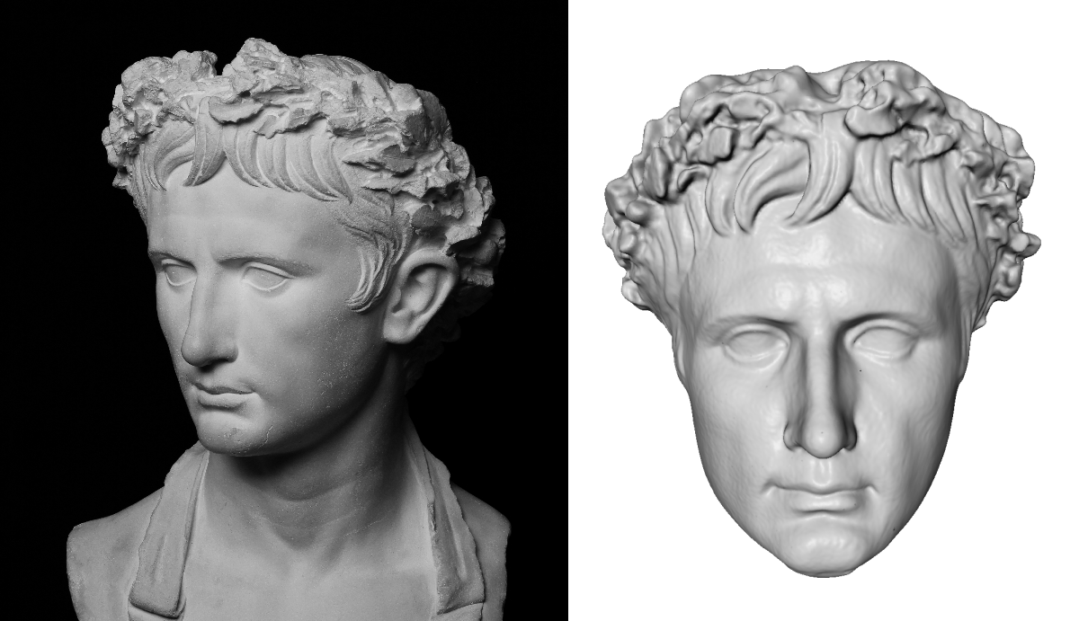
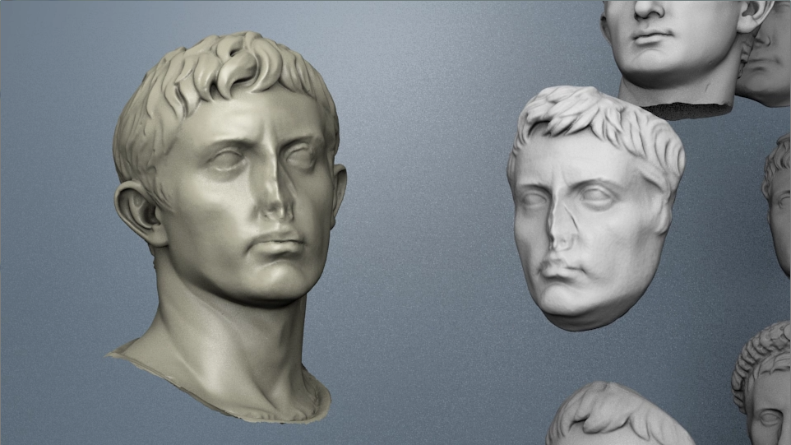
Motivation
Conservation and Analysis:
Knowledge shapes understanding of history
Preserve knowledge for future generations
Communicate knowledge by means of entertainment/visualization
More accessible to the general public
Combine Humanities with Computer Graphics

Slide 4
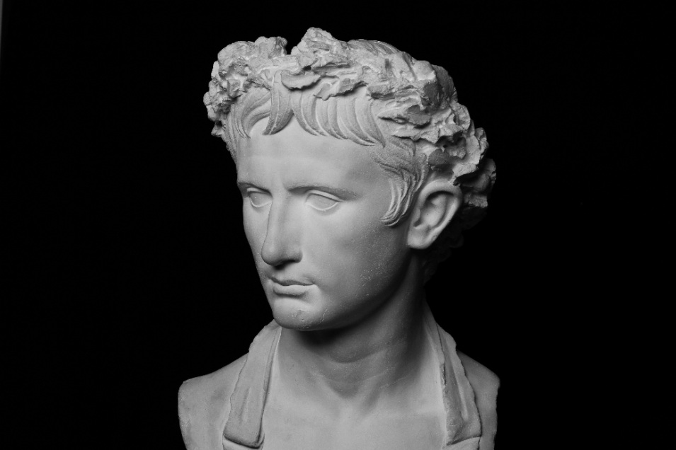
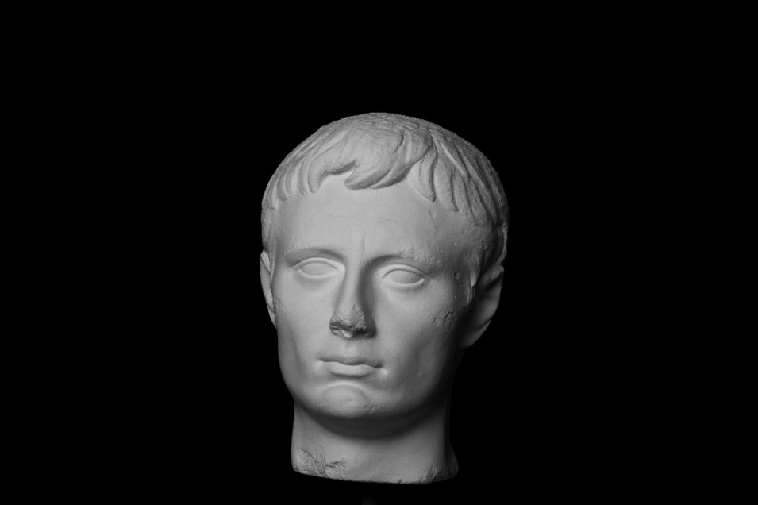
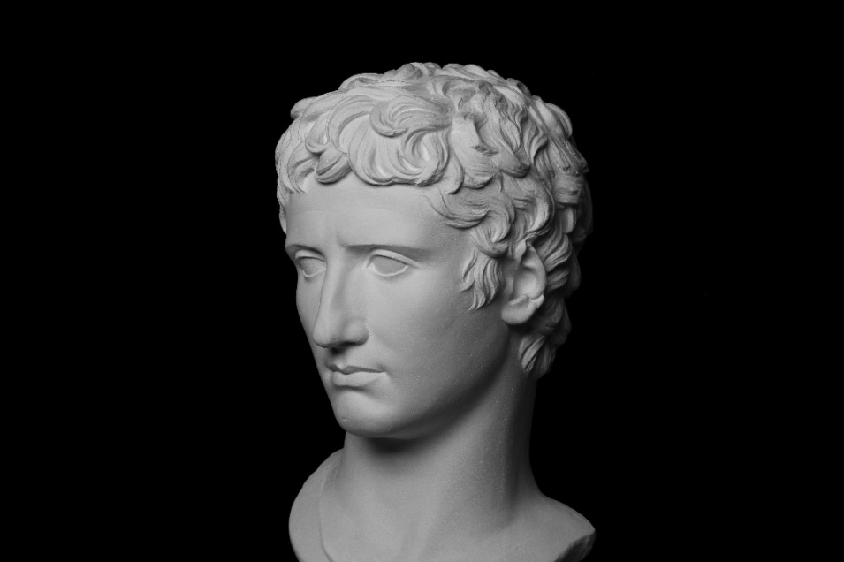
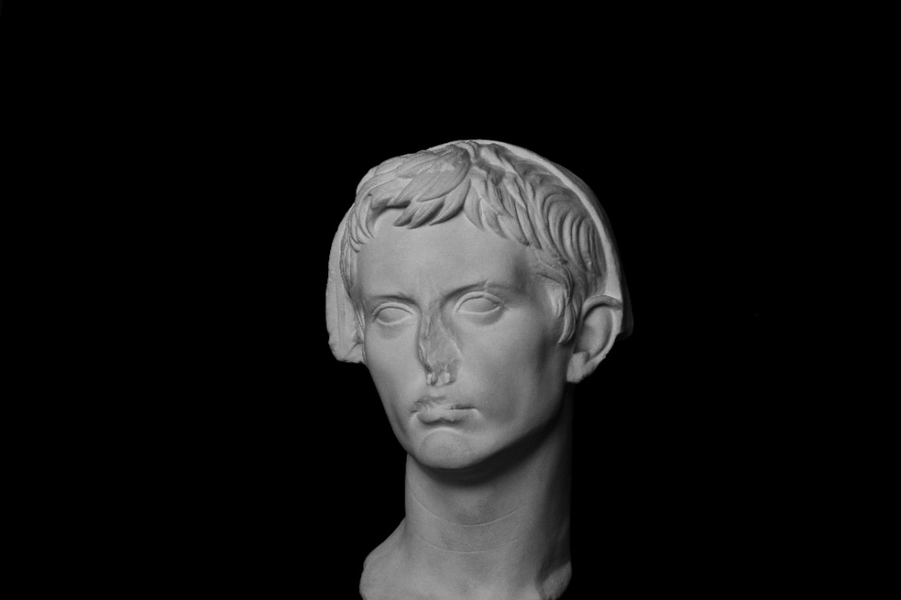
Data Acquisition - „Antikensammlung“ Erlangen
We started to scan busts of the famous emperor
Up to now: 15 busts of the „Antikensammlung“ Erlangen
Third largest collection of antiques in Bavaria
Main focus on Greek and Roman historical artefacts
450 plaster casts and 900 artefacts
Goal: Gather data for conservation and analysis

Slide 5
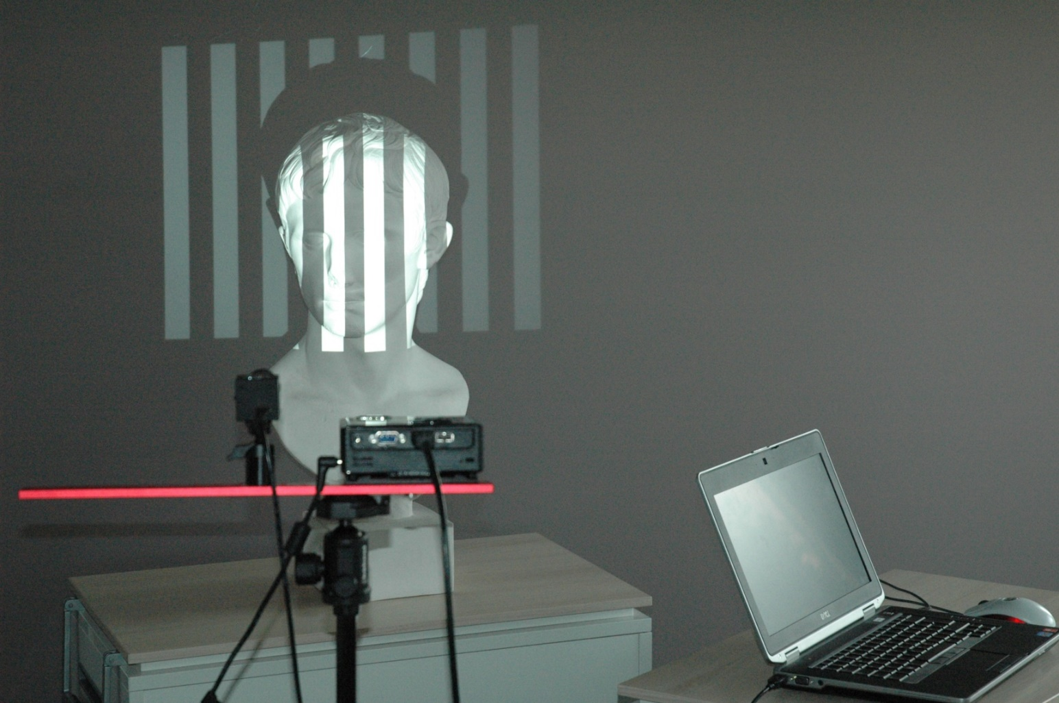
Data Acquisition - Setup
We use a portable structured light scanner
DAVID SLS-1
High quality reconstruction (sub-millimeter accuracy)
Depends on size of scanned object

Slide 6
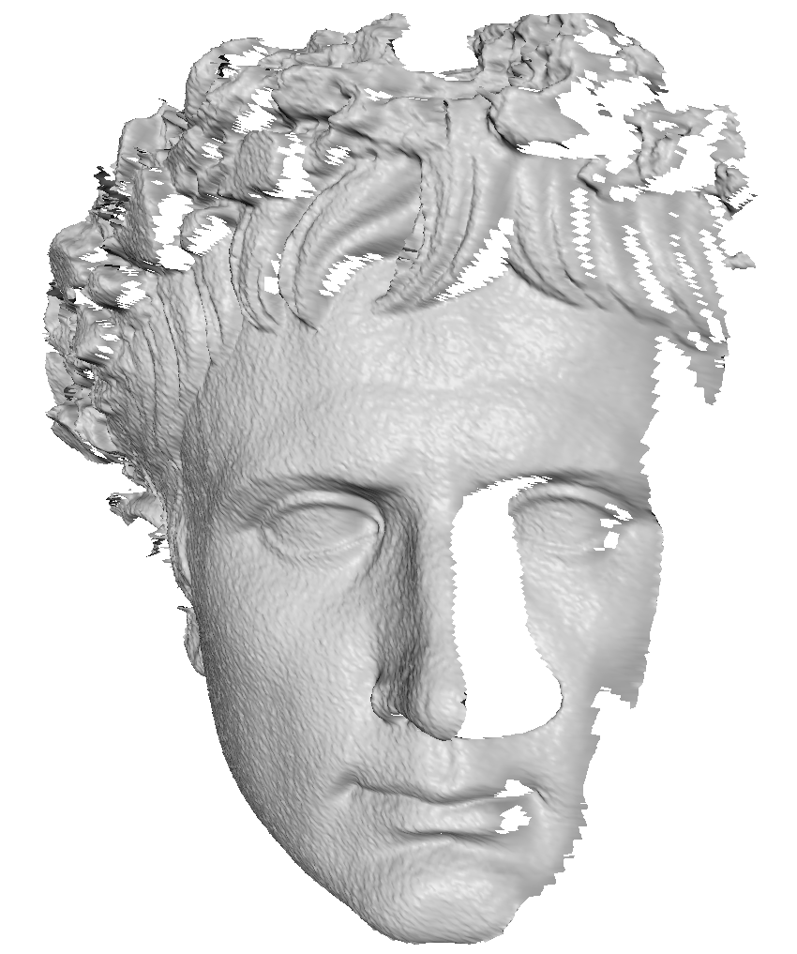
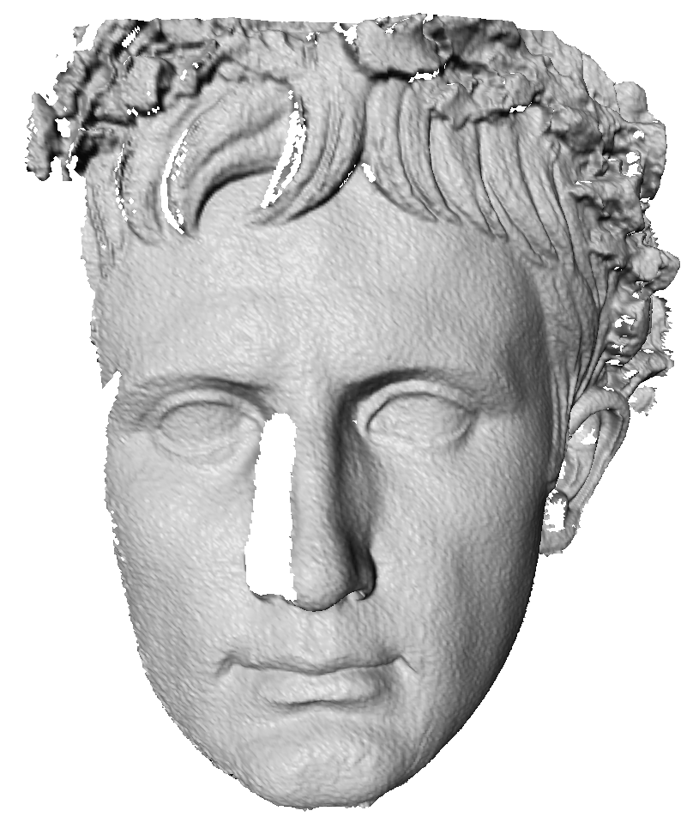
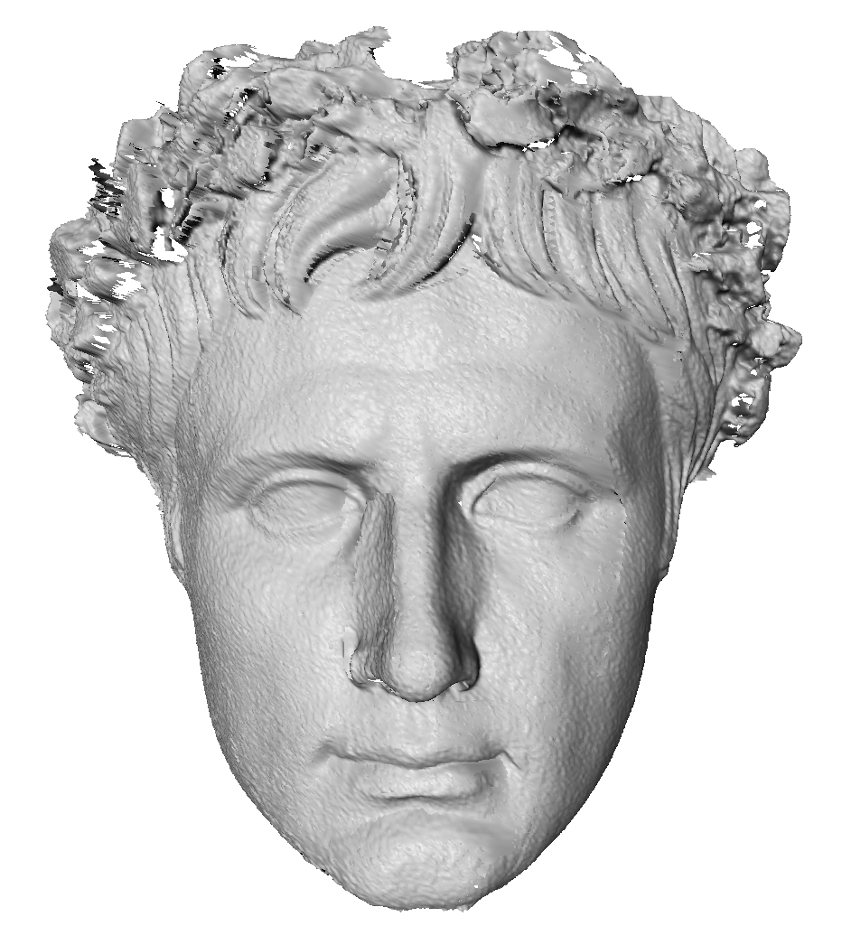
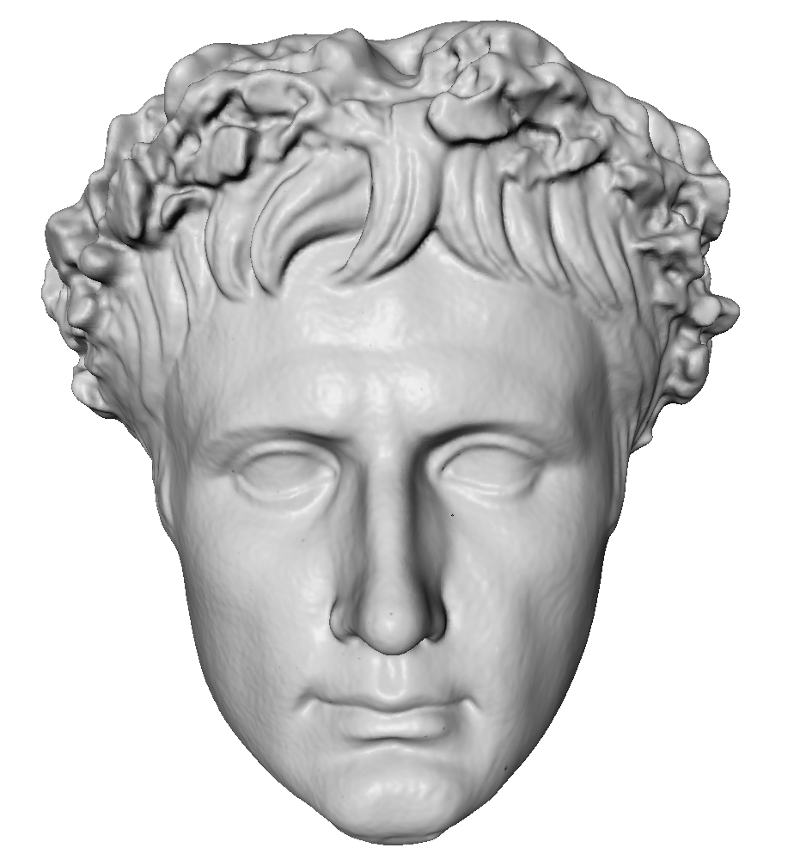
Data Reconstruction
Acquire multiple 3D-Scans
Scans not in common coordinate frame
Compute best rigid alignment
[Besl92, Chen92]
Single watertight surface by merging scans
Poisson Surface Reconstruction
[Kazhdan06]
High-Quality 3D-Reconstruction

Slide 7
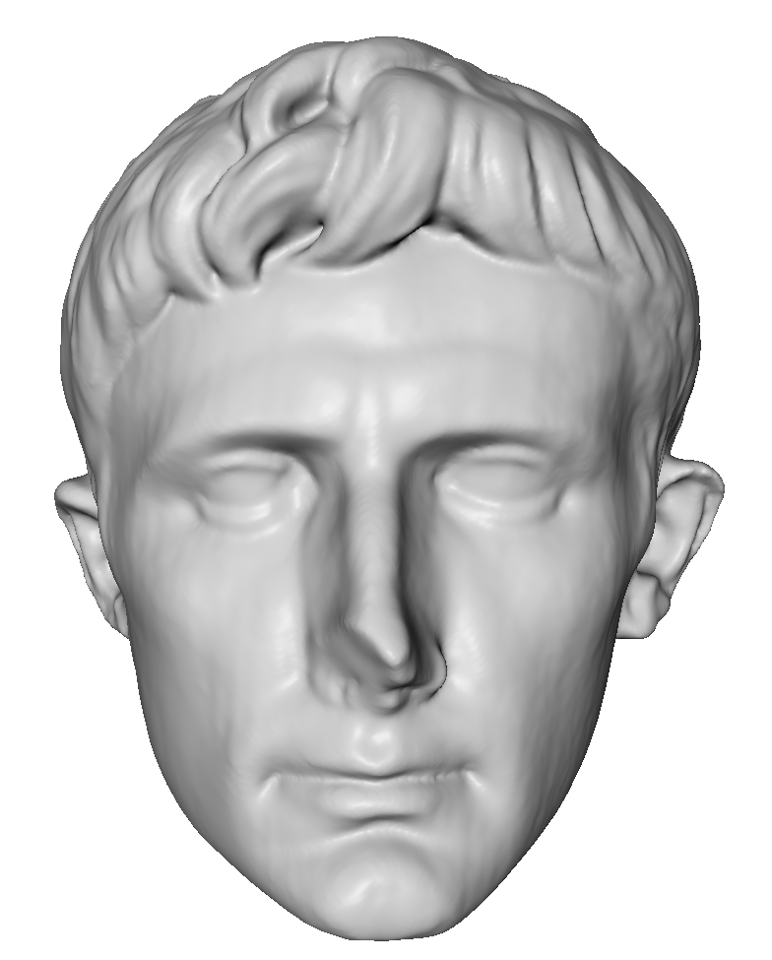
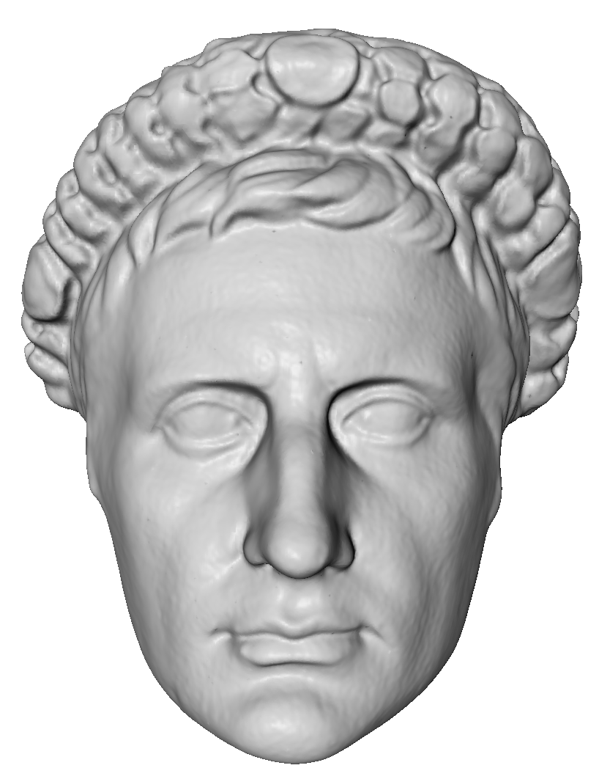
Data Reconstruction - Problem
3D-Scans have different topology
No information about corresponding regions
Which part of the model correspond to the nose, eyes, etc…
?
?

Slide 8
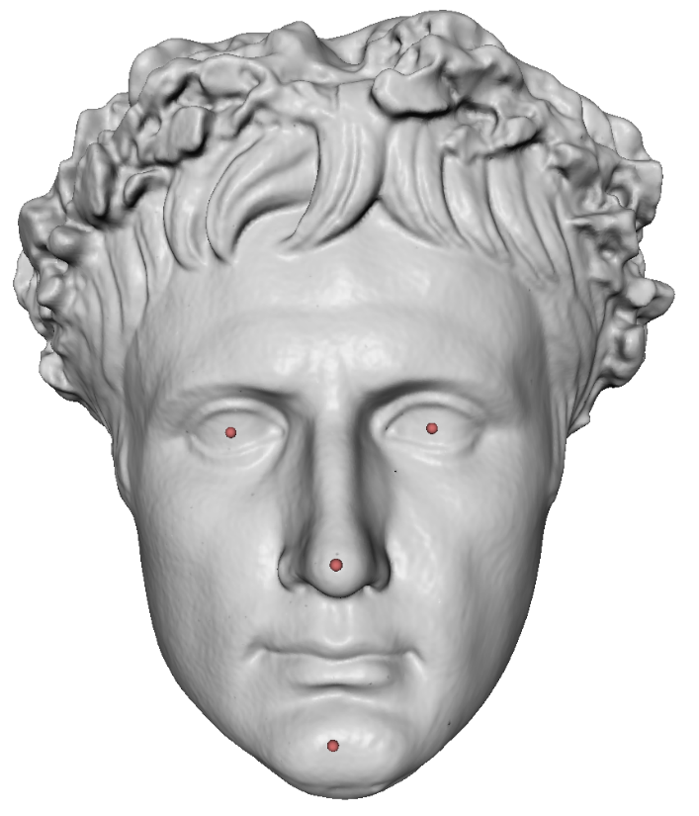
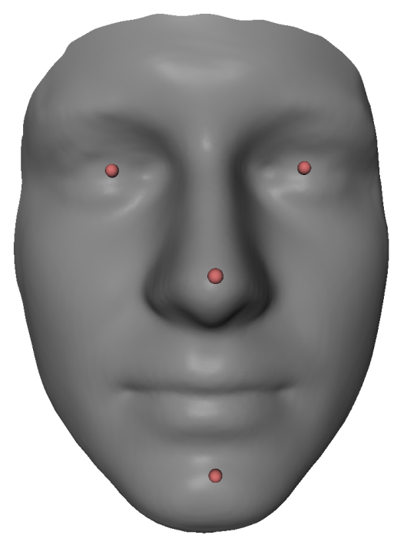
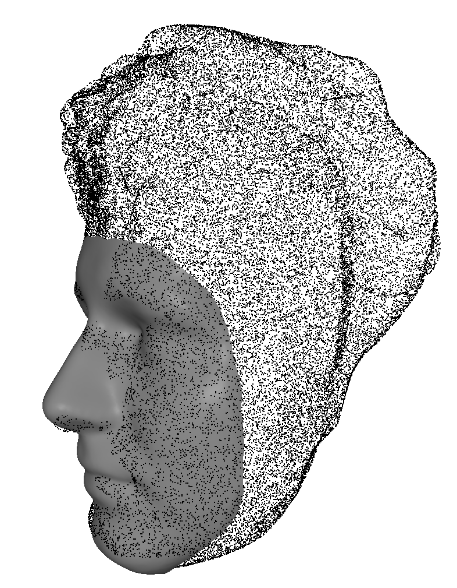
Rigid Registration
We start with a sparse set of manually placed correspondences
Template mask and 3D-Scan
Compute best rigid transformation [Schönemann66] and scaling
Convert mask and 3D-Scan to a common coordinate system:
Same orientation, position and scale

Slide 9
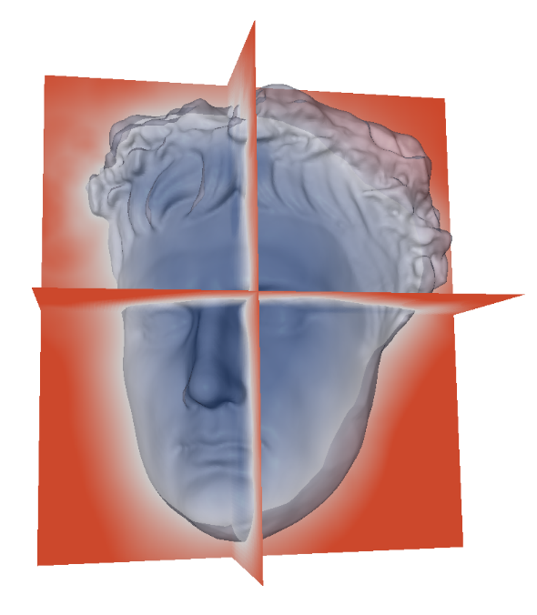
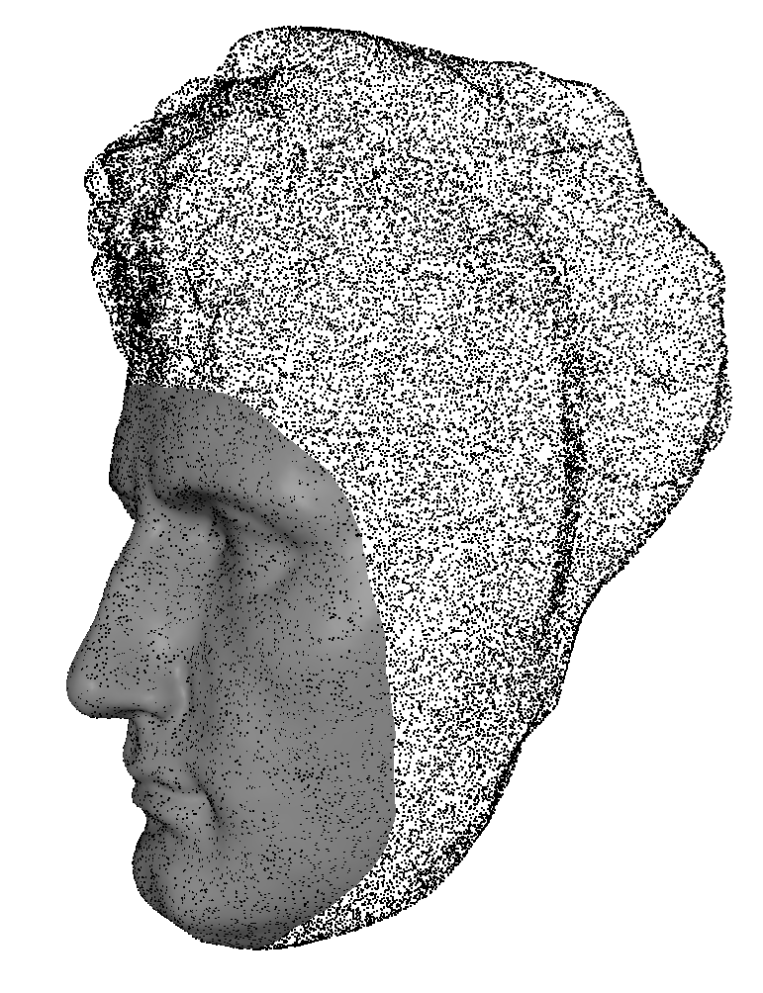
Non-Rigid Registration
Fit template mask using non-rigid surface registration
Warp template such that it fits the input
Two steps [Süßmuth10]:
Coarse Alignment
Deformation Graph [Sumner 07]
Fit to implicit function of target
Fine Alignment
Optimize vertex positions directly
ARAP Regularization [Sorkine07]
Point-point distance measure

Slide 10
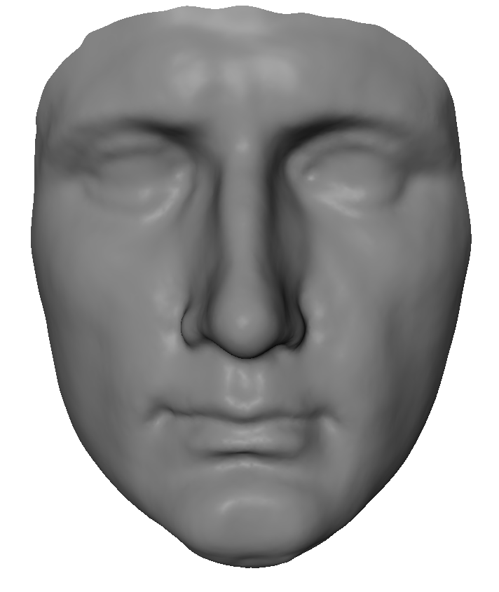
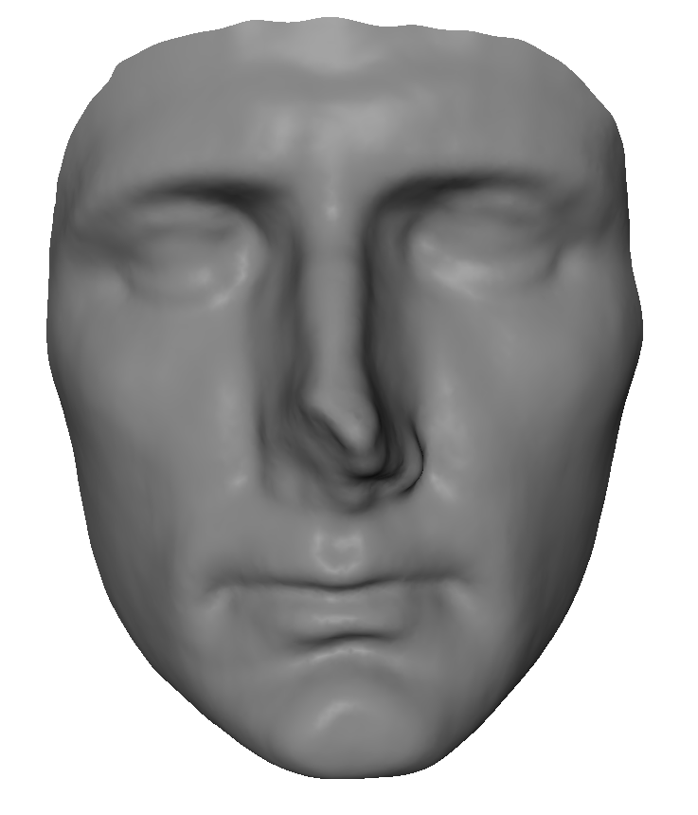
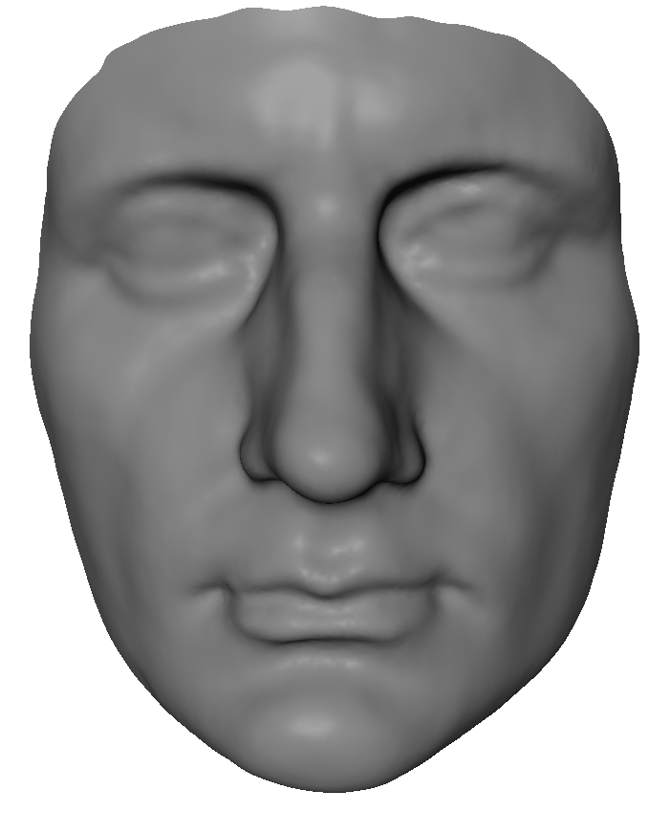
Non-Rigid Registration - Result
A set of masks with the same topology
Dense point-to-point correspondences
Basis for further processing:
Statistical Model, Virtual Restoration, Animation Transplantation, …

Slide 11
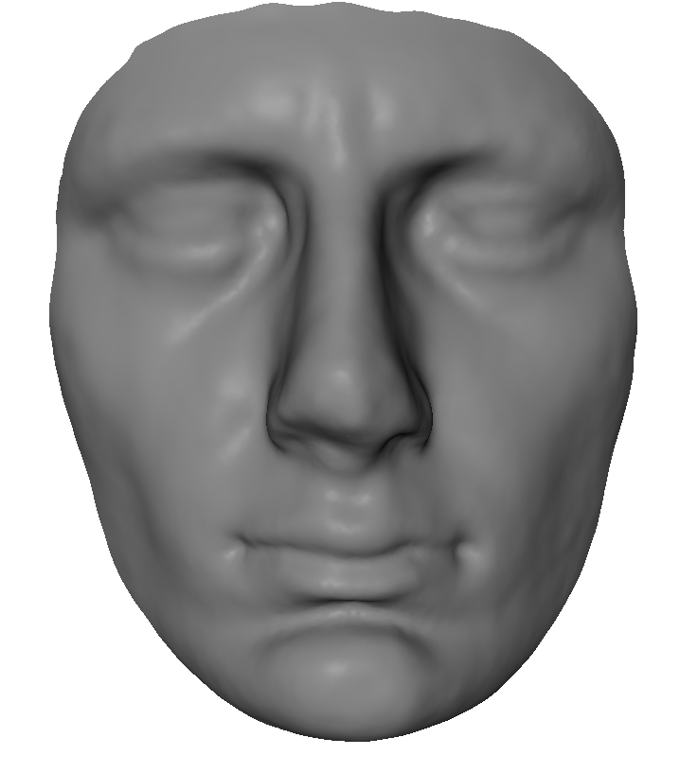
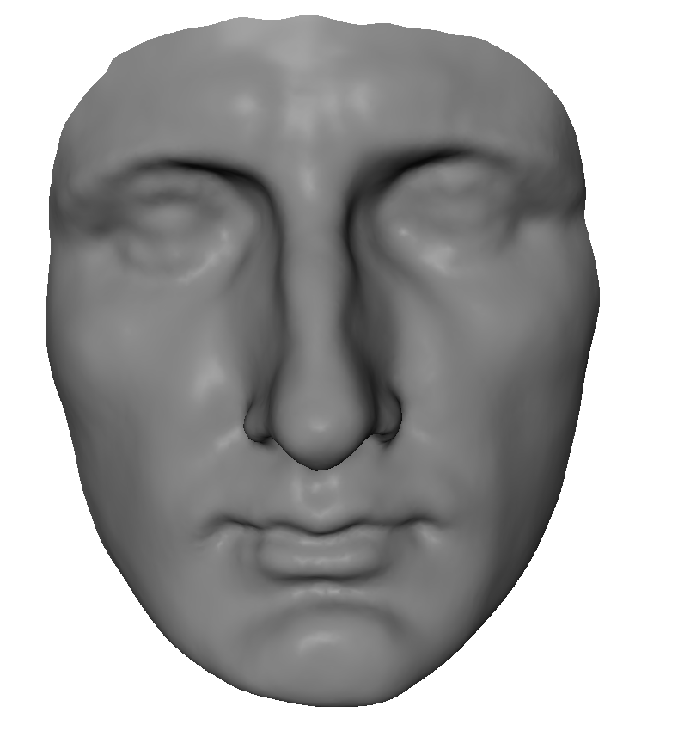
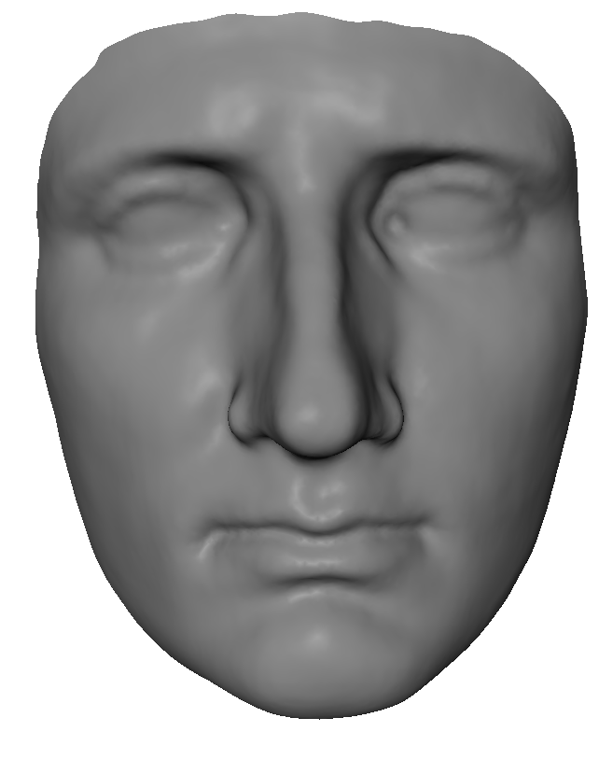
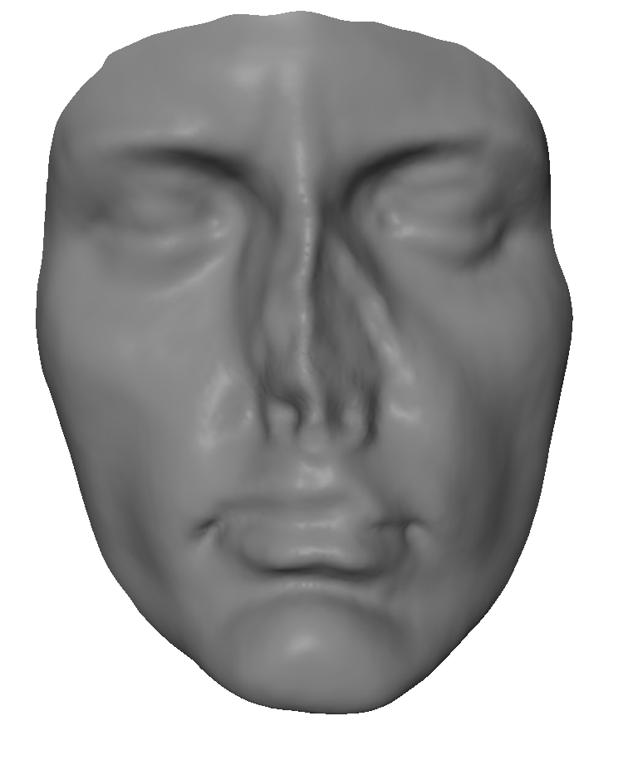
Statistical Face Model
Database of 3D-Scans:
Dense point-to-point correspondences
Same topology
Statistical Analysis
Linear space spanned by scans
[Blanz99, Blanz07]
Dimensionality reduction (PCA)
Visually explore most common variations

Slide 12
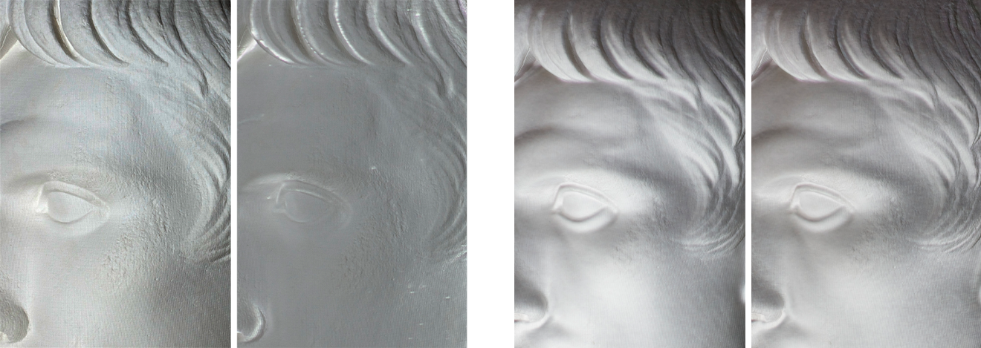
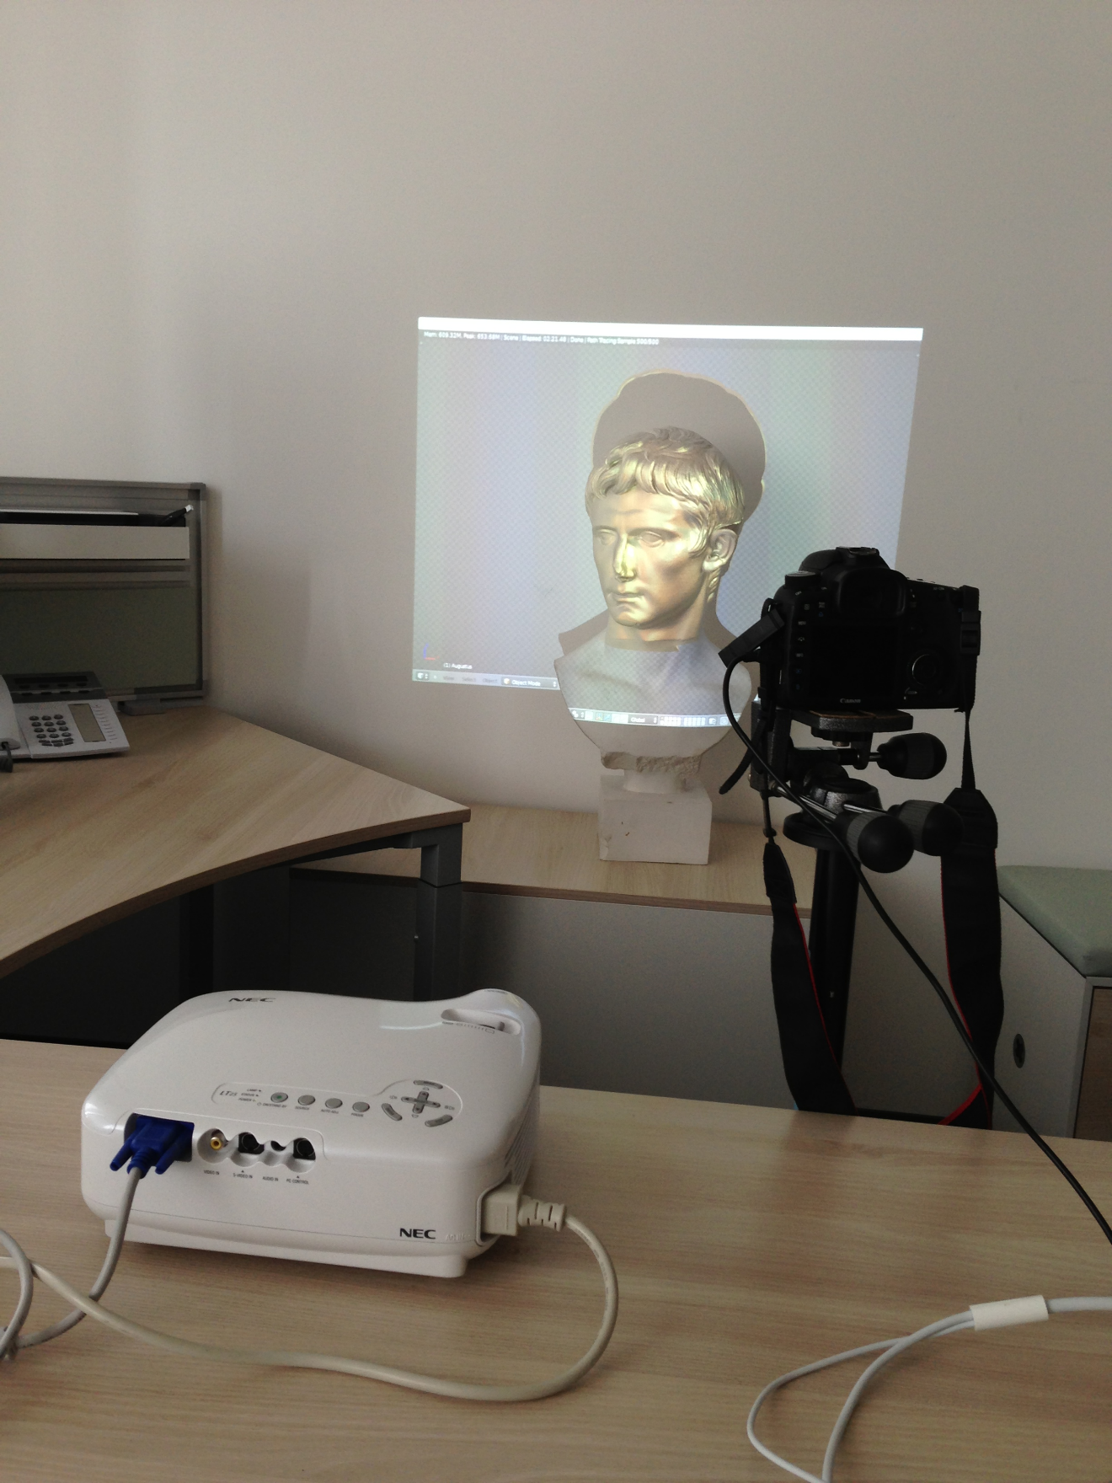
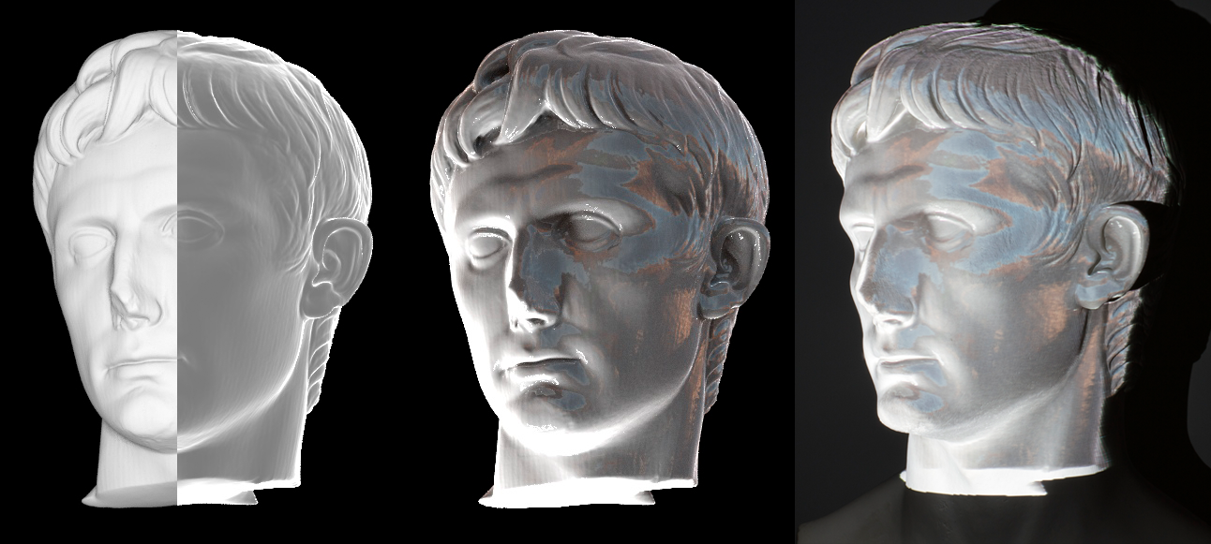
Applications - Virtual Painting
Modify virtual scene
Material, Illumination, Paint
Generate Image
Apply anti-shading
Project onto real world object
Requires registration between virtual and real world objects

Slide 13
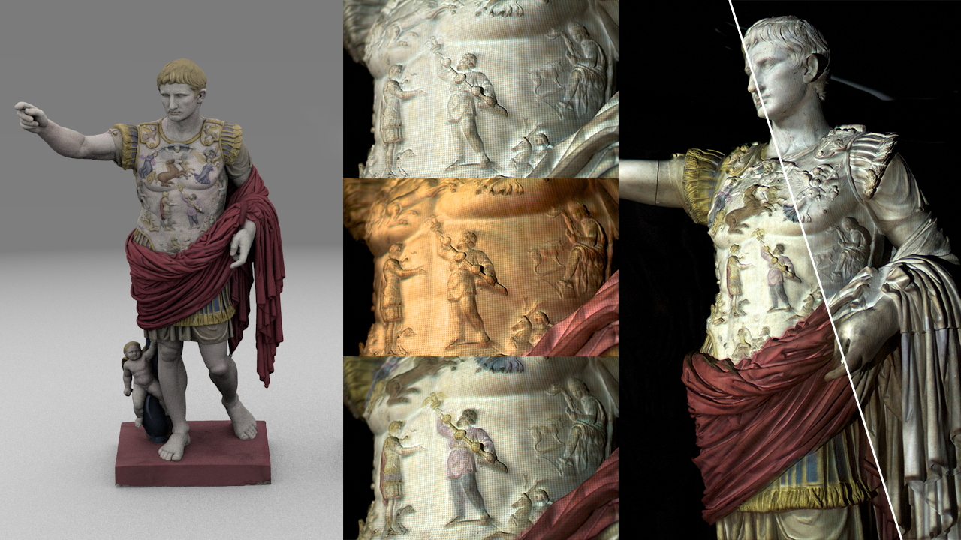
Applications - Virtual Painting

Slide 14
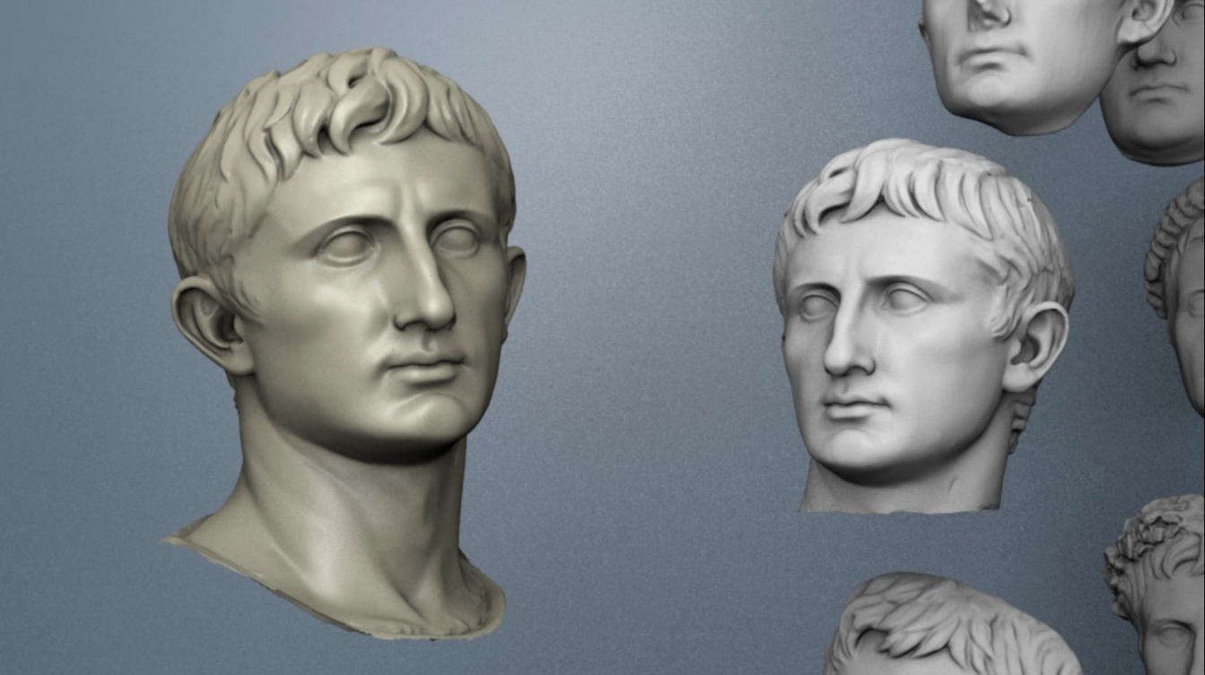
Applications - Visualizing Differences in Busts
Requires:
Dense point-to-point mapping
Morph in linear blend space
Seamless blending
Visualize geometric differences
Different archetypes
VIDEO/DEMO

Slide 15
Applications - Virtual Restoration of Artefacts
Use dense inter surface mapping to transplant geometry between scans:
Find best fitting artefact in linear blend space
Transplant geometry in damaged regions
VIDEO/DEMO

Slide 16
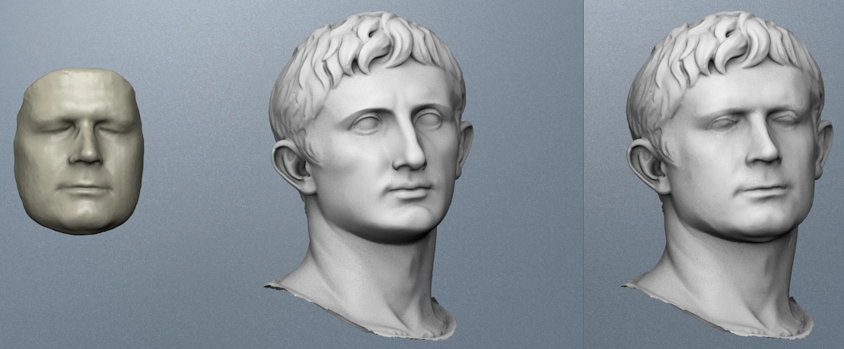
Applications - Augustification
Requires:
Dense point-to-point mapping
Transfer intrinsic shape/identity of person to a statue
Preserve statue-like appearance (Be your own emperor!)

Slide 17
Applications - Animation Retargeting
Revive ancient artefacts:
Capture animation with real-time 3D-Scanner
Transfer animation to ancient artefact
Preserve identity
VIDEO/DEMO

Slide 18
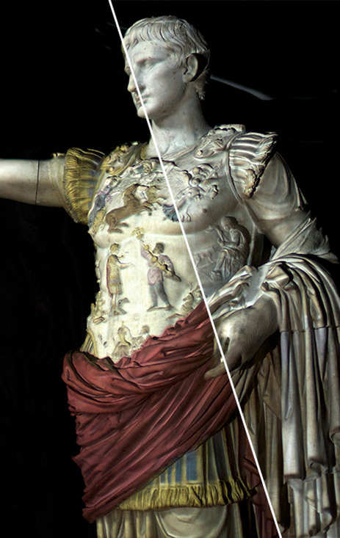
Conclusion/Future Work
Foundation for applications:
Dense inter surface mapping
Robust Non-Rigid Registration
Applications demonstrate:
Symbiosis of different disciplines
Humanities and Computer Graphics
Explore further applications
Present to larger audiences

