Slide 1
DispVoxNets: Non-Rigid Point Set Alignment
with Supervised Learning Proxies
Soshi Shimada^{1,2} Vladislav Golyanik³ Edgar Tretschk³
Didier Stricker^{1,2} Christian Theobalt³
¹University of Kaiserslautern ²DFKI ³MPI for Informatics, SIC

Slide 2
Non-rigid Point Set Registration (NRPSR)

Slide 3
Non-rigid Point Set Registration (NRPSR)
Objective: recovery of a displacement field aligning template and reference point sets
as well as correspondences between those

Slide 4
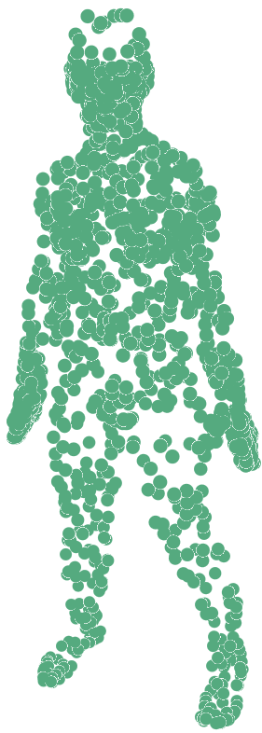
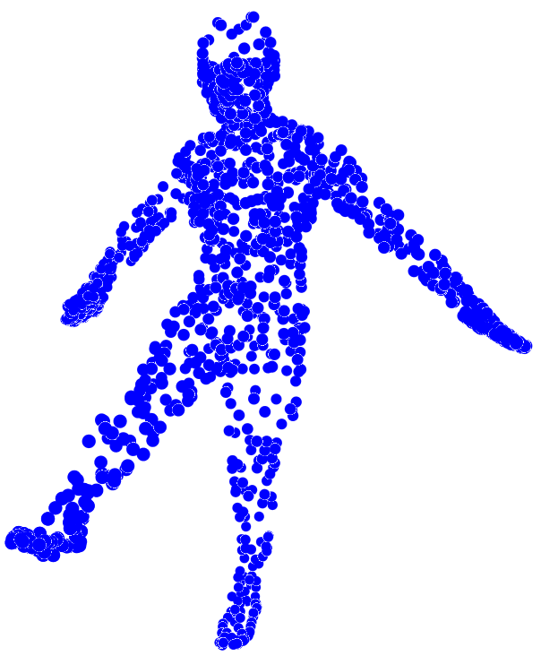
Non-rigid Point Set Registration (NRPSR)
Objective: recovery of a displacement field aligning template and reference point sets
as well as correspondences between those
Reference
Template

Slide 5
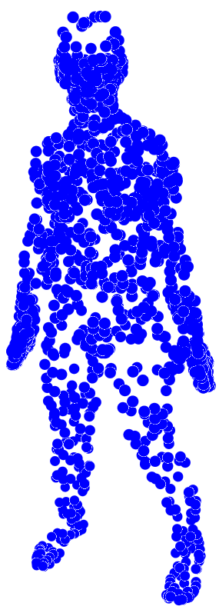
Non-rigid Point Set Registration (NRPSR)
Objective: recovery of a displacement field aligning template and reference point sets
as well as correspondences between those
Reference
Apply Displacements
Template
Registered Output

Slide 6
Non-rigid Point Set Registration (NRPSR)

Slide 7
Non-rigid Point Set Registration (NRPSR)
We propose a neural-network-based approach to estimate a displacement function for NRPSR

Slide 8
Non-rigid Point Set Registration (NRPSR)
We propose a neural-network-based approach to estimate a displacement function for NRPSR

Slide 9
Non-rigid Point Set Registration (NRPSR)
We propose a neural-network-based approach to estimate a displacement function for NRPSR
Neural Network

Slide 10
Non-rigid Point Set Registration (NRPSR)
We propose a neural-network-based approach to estimate a displacement function for NRPSR
Neural Network

Slide 11
Pipeline

Slide 12
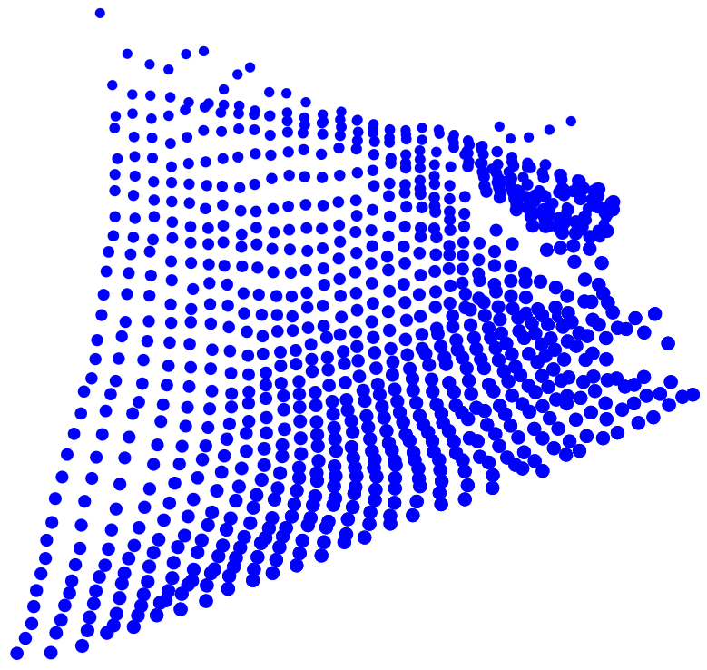
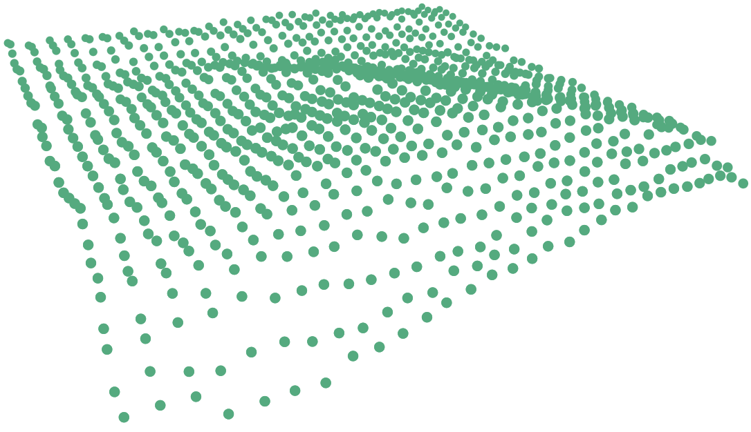
Pipeline
Y: template point set, X: reference point set

Slide 13
Pipeline
Y: template point set, X: reference point set
Assume M is not equal to N in general

Slide 14
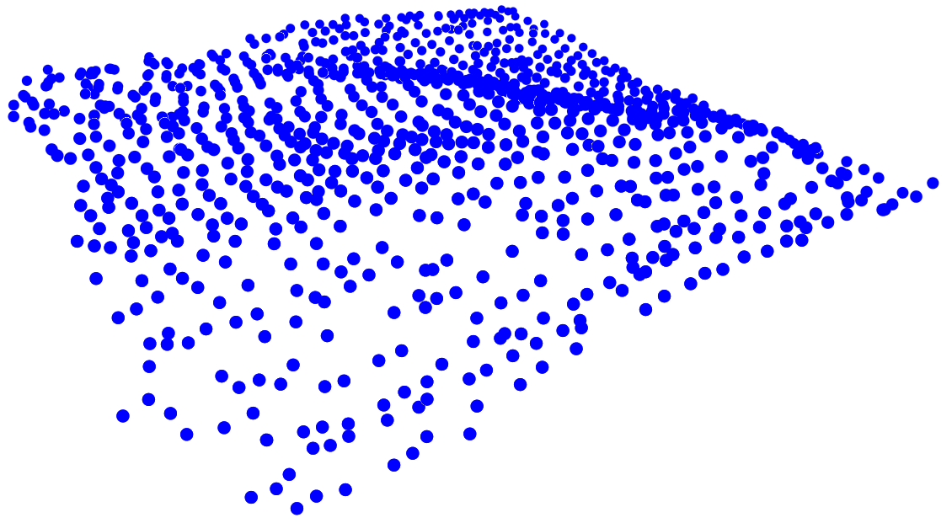
Pipeline
Displacement Estimation (DE)
Refinement
Y: template point set, X: reference point set
Assume M is not equal to N in general
Our pipeline is composed of two stages: DE and Refinement stage

Slide 15
Pipeline
Displacement Estimation (DE)
Refinement
Y: template point set, X: reference point set
Assume M is not equal to N in general
Our pipeline is composed of two stages: DE and Refinement stage
DE stage regresses global displacements between Y and X

Slide 16
Pipeline
Displacement Estimation (DE)
Refinement
Y: template point set, X: reference point set
Assume M is not equal to N in general
Our pipeline is composed of two stages: DE and Refinement stage
DE stage regresses global displacements between Y and X
Refinement stage improves the initial displacement values

Slide 17
Pipeline
P2V
Refinement
P2V
Y and X are firstly converted into voxel representation (P2V)

Slide 18
Pipeline
P2V
Refinement
P2V
Y and X are firstly converted into voxel representation (P2V)
During the conversion, voxel-point correspondence information is stored in an affinity table

Slide 19
Pipeline
P2V
z
Refinement
y
P2V
x
DispVoxNet
Y and X are firstly converted into voxel representation (P2V)
During the conversion, voxel-point correspondence information is stored in an affinity table
DispVoxNet accepts the two voxel grids and returns voxel displacements

Slide 20
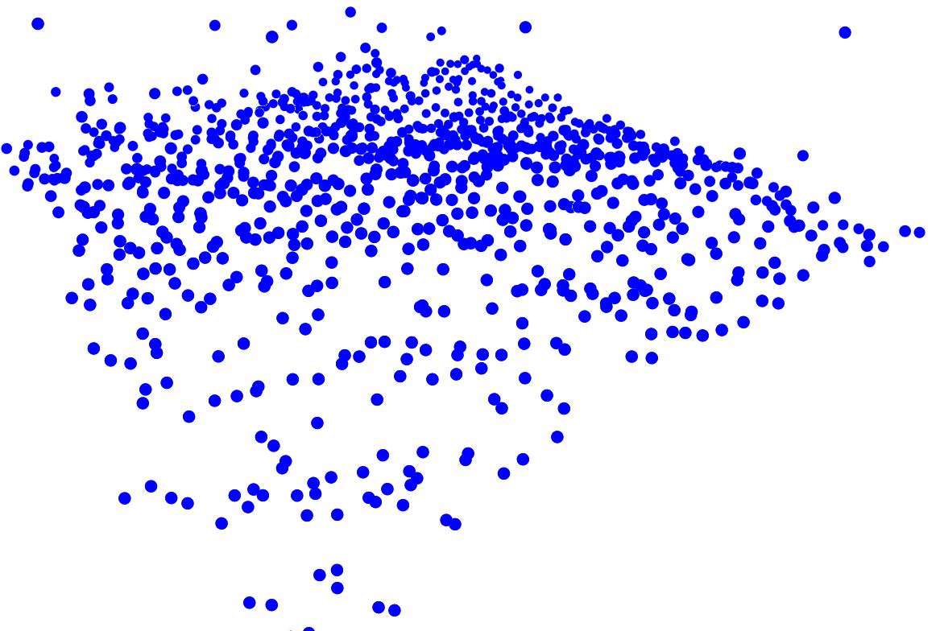
Pipeline
P2V
z
Refinement
y
V2P
P2V
x
DispVoxNet
Y and X are firstly converted into voxel representation (P2V)
During the conversion, voxel-point correspondence information is stored in an affinity table
DispVoxNet accepts the two voxel grids and returns voxel displacements
The displacements are applied using the affinity table at the end of DE stage

Slide 21
Pipeline
P2V
z
y
V2P
P2V
P2V
x
DispVoxNet
DispVoxNet
The outputs from the DE stage are further sent to the Refinement stage after P2V

Slide 22
Pipeline
P2V
z
z
y
V2P
P2V
P2V
y
x
DispVoxNet
x
DispVoxNet
The outputs from the DE stage are further sent to the Refinement stage after P2V
The new instance of DispVoxNet returns small displacements for surface smoothing

Slide 23
Pipeline
P2V
z
z
y
V2P
P2V
P2V
y
V2P
x
DispVoxNet
x
DispVoxNet
The outputs from the DE stage are further sent to the Refinement stage after P2V
The new instance of DispVoxNet returns small displacements for surface smoothing
The inferred displacements are added to the template poins using trilinear interpolation on the eight nearest displacements for each template points.

Slide 24
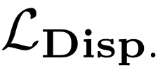
Pipeline
P2V
z
z
y
V2P
P2V
P2V
y
V2P
x
DispVoxNet
x
DispVoxNet

Slide 25
Pipeline
P2V
z
z
y
V2P
P2V
P2V
y
V2P
x
DispVoxNet
x
DispVoxNet
The network in the DE stage is trained in a supervised manner (displacement loss)

Slide 26
Pipeline
P2V
z
z
y
V2P
P2V
P2V
y
V2P
x
DispVoxNet
x
DispVoxNet
The network in the DE stage is trained in a supervised manner (displacement loss)
The network in the Refinement stage is trained in an unsupervised manner (point projection loss)

Slide 27
Pipeline
P2V
z
z
y
V2P
P2V
P2V
y
V2P
x
DispVoxNet
x
DispVoxNet

Slide 28
Pipeline
P2V
z
z
y
V2P
P2V
P2V
y
V2P
x
DispVoxNet
x
DispVoxNet
The pipeline has to be fully differentiable for gradient backpropagation from the loss computations

Slide 29
Pipeline
P2V
z
z
y
V2P
P2V
P2V
y
V2P
x
DispVoxNet
x
DispVoxNet
The pipeline has to be fully differentiable for gradient backpropagation from the loss computations
However, the conversion from voxel grid to point set (V2P) is not fully differentiable

Slide 30
Pipeline
P2V
z
z
y
V2P
P2V
P2V
y
V2P
x
DispVoxNet
x
DispVoxNet
The pipeline has to be fully differentiable for gradient backpropagation from the loss computations
However, the conversion from voxel grid to point set (V2P) is not fully differentiable
Therefore, we need a bridge in the V2P process (red rectangle) to propagate the gradients from

Slide 31
Solution for Back Propagation in V2P

Slide 32
Solution for Back Propagation in V2P
: Inferred Displacement
: Trilinear Interpolation
: Template Point
: Forward
: Backward

Slide 33
Solution for Back Propagation in V2P
: Inferred Displacement
: Trilinear Interpolation
: Template Point
: Forward
: Backward
Compute trilinear weights for each template point using its 8 nearest inferred displacements

Slide 34
Solution for Back Propagation in V2P
: Inferred Displacement
Affinity
Table
: Trilinear Interpolation
: Template Point
: Forward
: Backward
Compute trilinear weights for each template point using its 8 nearest inferred displacements
Record the weights and indices of the 8 nearest displacements in the affinity table

Slide 35
Solution for Back Propagation in V2P
: Inferred Displacement
Affinity
Table
: Trilinear Interpolation
: Template Point
: Forward
: Backward
Compute trilinear weights for each template point using its 8 nearest inferred displacements
Record the weights and indices of the 8 nearest displacements in the affinity table
Compute the point projection loss

Slide 36
Solution for Back Propagation in V2P
: Inferred Displacement
Affinity
Table
: Trilinear Interpolation
: Template Point
: Forward
: Backward
Compute trilinear weights for each template point using its 8 nearest inferred displacements
Record the weights and indices of the 8 nearest displacements in the affinity table
Compute the point projection loss
Distribute gradients following the IDs and weights information recorded in the affinity table in II.

Slide 37
Training

Slide 38
Training
We train the DispVoxNets in two consecutive phases.

Slide 39
Training
We train the DispVoxNets in two consecutive phases.
Phase 1: train the DispVoxNet in the DE stage using the displacement loss until convergence

Slide 40
Training
We train the DispVoxNets in two consecutive phases.
Phase 1: train the DispVoxNet in the DE stage using the displacement loss until convergence
Phase 2: another instance of DispVoxNet in the Refinement stage is trained using only the PP Loss

Slide 41
Training
We train the DispVoxNets in two consecutive phases.
Phase 1: train the DispVoxNet in the DE stage using the displacement loss until convergence
Phase 2: another instance of DispVoxNet in the Refinement stage is trained using only the PP Loss
During the training, we remove some points from Y and X, and add uniform-noise to the two point sets uniformly at random.

Slide 42
Dataset

Slide 43
Dataset
thin plate
[Golyanik et al. 2018]
FLAME
[Li et al. 2017]
DFAUST
[Bogo et al. 2017]
cloth
[Bednařík et al. 2018]

Slide 44
Dataset
thin plate
[Golyanik et al. 2018]
FLAME
[Li et al. 2017]
DFAUST
[Bogo et al. 2017]
cloth
[Bednařík et al. 2018]
We train/evaluate our approach with four datasets from different modalities

Slide 45
Evaluations

Slide 46
Baseline comparison

Slide 47
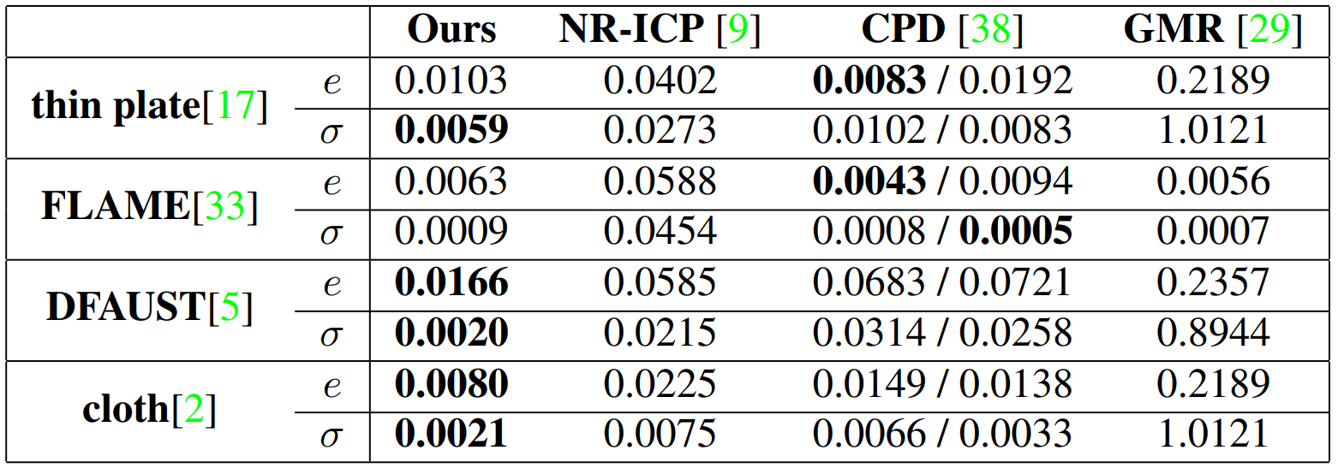
Baseline comparison

Slide 48
Baseline comparison
e and stands for the average root-mean-squared-error (RMSE) and its standard deviation respectively

Slide 49
Baseline comparison
e and stands for the average root-mean-squared-error (RMSE) and its standard deviation respectively
Our approach outperforms others especially on the dataset with large non-linear deformations between the point sets, i.e., DFAUST and cloth.

Slide 50
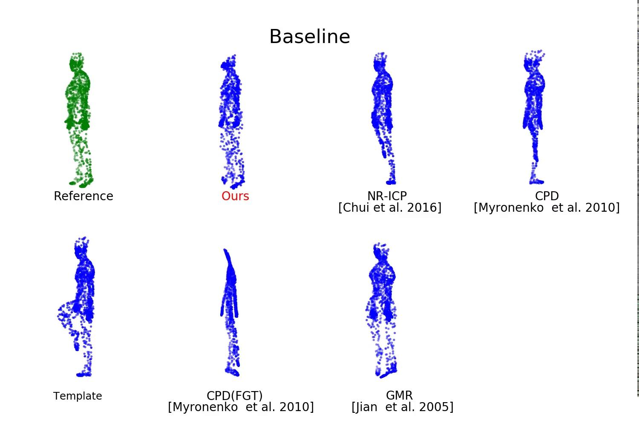

Slide 51
Outliers

Slide 52
Outliers

Slide 53
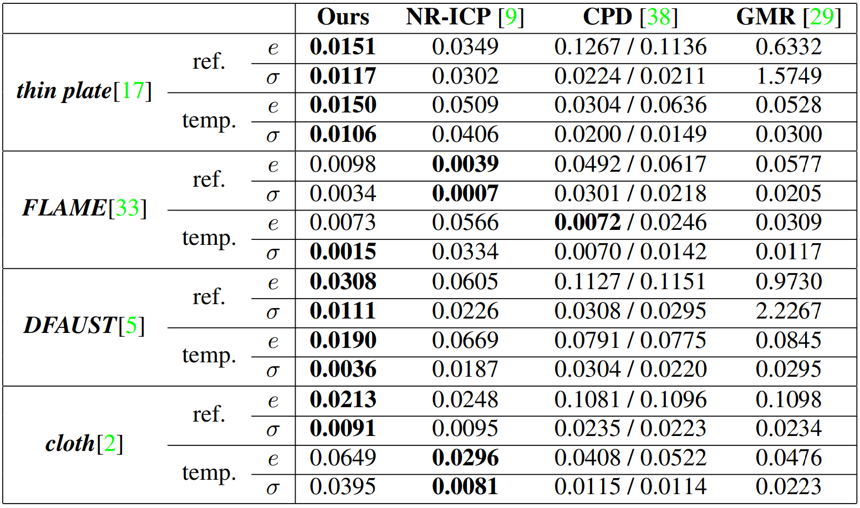
Outliers

Slide 54
Outliers
Error comparison on the datasets with a sphere outlier

Slide 55
Outliers
Error comparison on the datasets with a sphere outlier
“ref.” and “temp.” denote whether the outlier is added to the reference or template, respectively

Slide 56
Outliers
Error comparison on the datasets with a sphere outlier
“ref.” and “temp.” denote whether the outlier is added to the reference or template, respectively
On most of the datasets, our approach shows the lowest RMSE and stable performances

Slide 57
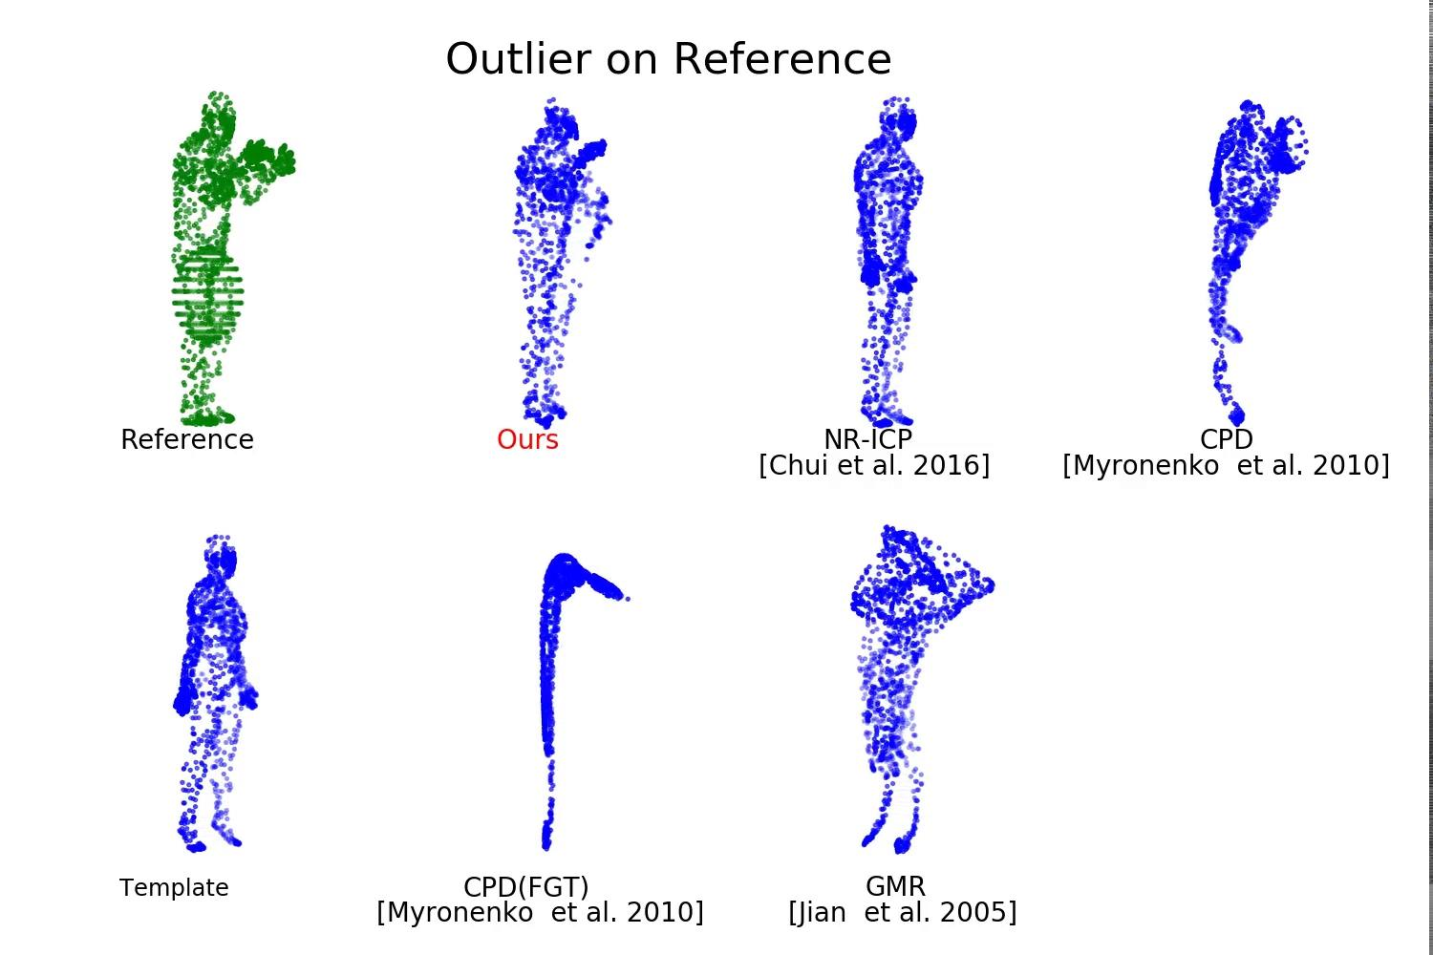

Slide 58
Chunk Removal

Slide 59
Chunk Removal

Slide 60
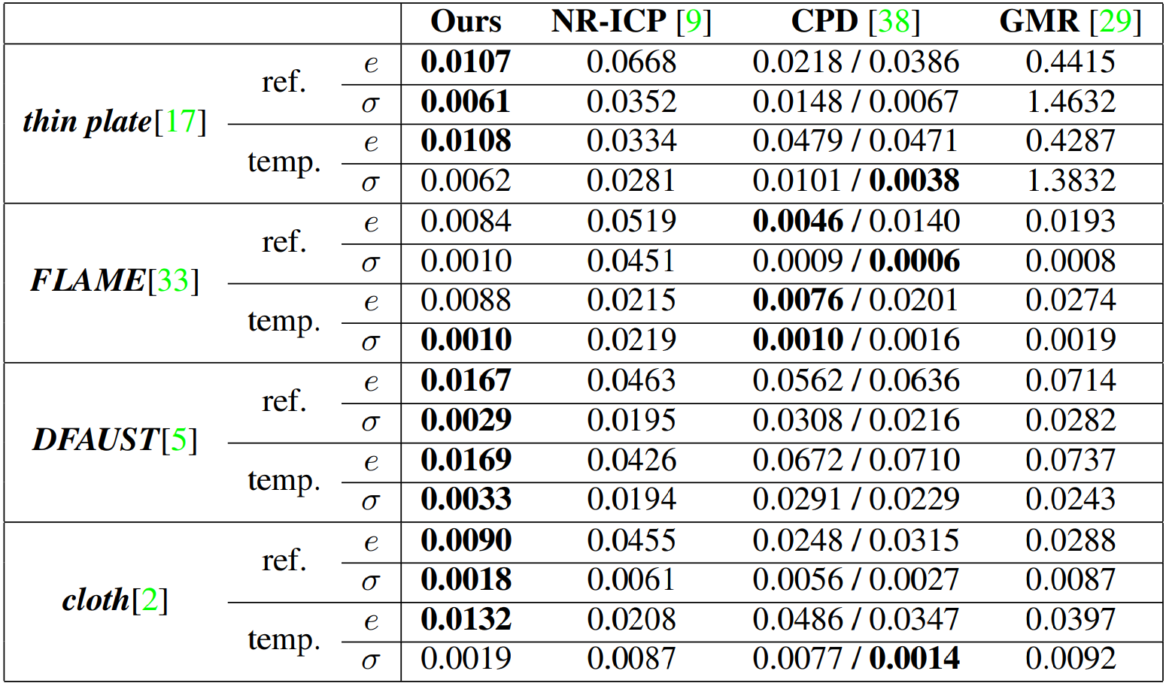
Chunk Removal

Slide 61
Chunk Removal
Error comparison on the datasets with chunk removal

Slide 62
Chunk Removal
Error comparison on the datasets with chunk removal
“Ref.” and “temp.” denote whether parts are removed from the reference or template, respectively

Slide 63
Chunk Removal
Error comparison on the datasets with chunk removal
“Ref.” and “temp.” denote whether parts are removed from the reference or template, respectively
In the same manner as the outlier scenario, our approach shows the lowest RMSE and stable performances on most of the datasets

Slide 65
Uniform Noises

Slide 66
Uniform Noises

Slide 67
Uniform Noises

Slide 68
Uniform Noises
Comparison of registration errors in the scenario with uniform noise

Slide 69
Uniform Noises
Comparison of registration errors in the scenario with uniform noise
The template noise ratio is the ratio between the number of noise points added to the template and the number of points in the unperturbed template

Slide 70
Uniform Noises
Comparison of registration errors in the scenario with uniform noise
The template noise ratio is the ratio between the number of noise points added to the template and the number of points in the unperturbed template
DispVoxNets show stable accuracy across different noise ratios and datasets, whereas other methods are significantly affected by the uniform noises

Slide 71
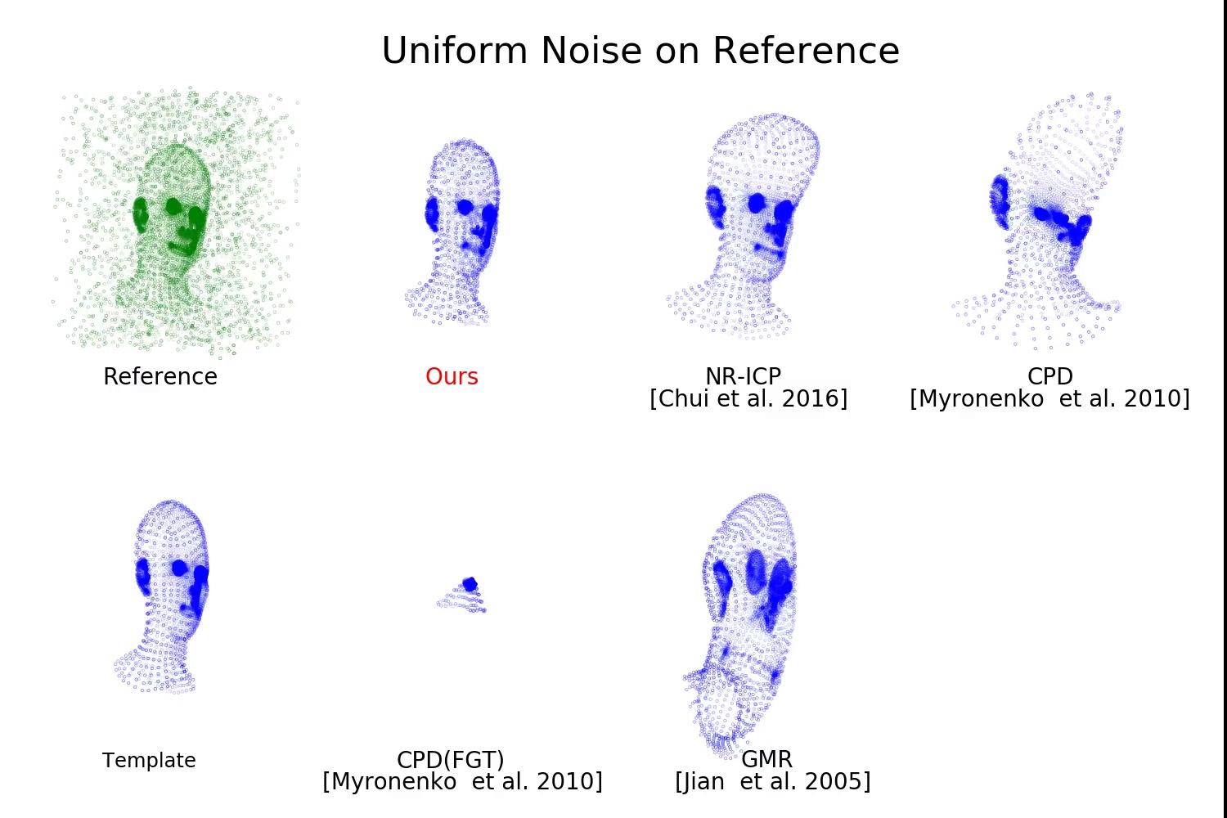

Slide 72
Real-face Dataset

Slide 73
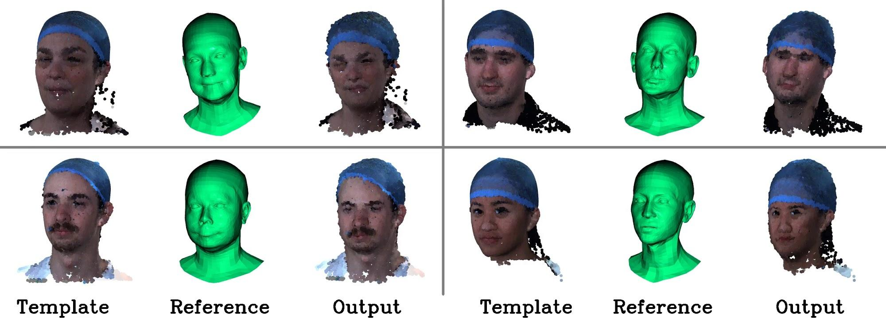

Slide 74
DispVoxNets: Non-Rigid Point Set Alignment
with Supervised Learning Proxies
Soshi Shimada^{1,2} Vladislav Golyanik³ Edgar Tretschk³
Didier Stricker^{1,2} Christian Theobalt³
¹University of Kaiserslautern ²DFKI ³MPI for Informatics, SIC

